Slide 1


HR Analytics Project Supervised by DR: Ahmed Samir
This scholarship is provided by the Egyptian Ministry of Communications and the Digital Egypt Pioneers initiative.
CA12_DAT1_G6

Slide 2

Team Members
* Abeer Magdy Saad
* Malek Kamal EL_Sayed
* Rahma Maher Sayed
Insight Pioneers

Slide 3
Table Of Contents :
Introduction | Overview of the project and its purpose
Project objectives | What we aimed to achieve through this analysis
Data Sources & Structure | Datasets used and how they were combined
Data Cleaning & Preprocessing | Steps taken to prepare clean, usable data
Key Analysis Areas | The main themes explored in our HR analysis
Forecasting Trends | Predicting future HR challenges using data
Tableau Dashboard | Interactive visual summary of our findings
Recommendations | Data-driven suggestions for HR improvement

Slide 4

Introduction:
Our project focuses on analyzing HR data to uncover insights about the workforce.
We aim to understand employee behavior, satisfaction, attrition, and growth trends.
Tools used: Excel for raw data, Python & SQL for analysis, Tableau & Power Bi for dashboard visualization.

Slide 5


Project Objectives :
Analyze workforce data
Forecast Future Outcomes
Provide Recommendations
Identify HR Trends
Visualization

Slide 6
Data Source & Structure: we have one dataset consists of five files
01
02
03
04
05
Employees.xlsx
performanceRating.xlsx
RatingLevel.xlsx
SatisfiedLevel.xlsx
EducationLevel.xlsx

Slide 7
Data Cleaning & Preprocessing
Removed missing values and duplicates
Merged all files into one clean dataset
Used Python & SQL for preprocessing
Final dataset includes (36) columns & (6900) Rows

Slide 8




OUR NUMBERS
1470
3
13
Total Employees
Number of Departments
Number of Job Roles
3
Number of States

Slide 9
Key Analysis Areas
Employee & salary
Satisfaction & Engagement
Attrition & Turnover
Promotion &
Performance
Age , Gender , salary & Department
Work-Life balance
Job satisfaction & Overtime
Why Employees leave ?
Promotion History,Performnce & Years with Mangers

Slide 10
Insights of Employee & Salary :
Sales department has younger employees.
Technology has the highest average salary.
Gender distribution is skewed in some roles.
Majority of employees hold at least a Bachelor’s degree.
Salary increases with education & experience.

Slide 11
Insights of Satisfaction & Engagement:
Employees doing overtime are less satisfied.
Technology employees report the lowest work-life. balance
Low satisfaction can linked with high attrition.
Employees with Masters and Doctorate often show higher satisfaction.
Satisfaction varies by job role.

Slide 12
Insights of Attrition & Turnover :
Sales has the highest attrition rate.
Employees with long commutes are more likely to leave.
Younger employees tend to leave more often.
After 5+ years attrition tends to stabilize.
Higher education often correlates with better role and pay.

Slide 13
Insights of Promotion & Performance:
Many employees haven’t been promoted in over three years.
Lack promotion is linked with low engagement.
Tech department has fewer internal promotions.
Employees with Doctorates degrees often have faster promotion.

Slide 14
Forecasting Trends :
1.Employee Attrition :
Attrition Forecast: Predicted attrition rises sharply from 44 employees in 2023 to 76 in 2025-a 73% increase over three years. This step upward trend contrasts with the historical average of 21, suggesting factors like declining job satisfaction, competitive job markets, or insufficient retention strategies may be at play
2.Salary Analysis :
Salary Forecast: Average salaries are projected to grow steadily from $111,551 in 2023 to $121,905 in 2025-a 9.3% increase. While this growth is positive, it's slower than historical peaks (e.g., 2020's $126,860), indicating cautious compensation adjustments despite rising attrition.

Slide 15
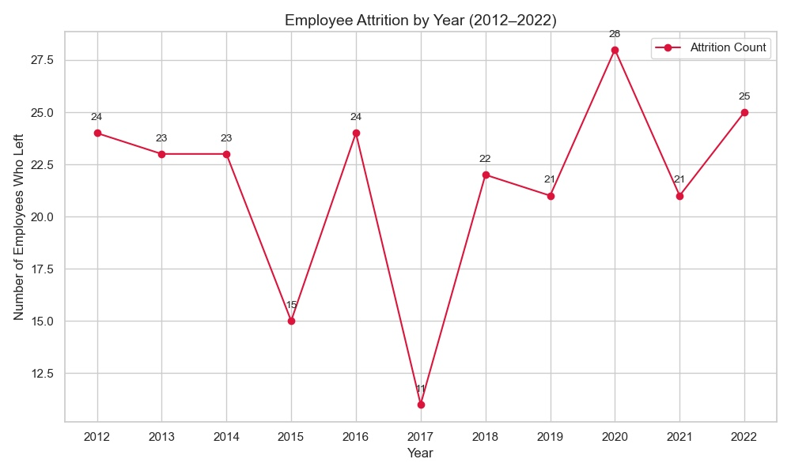
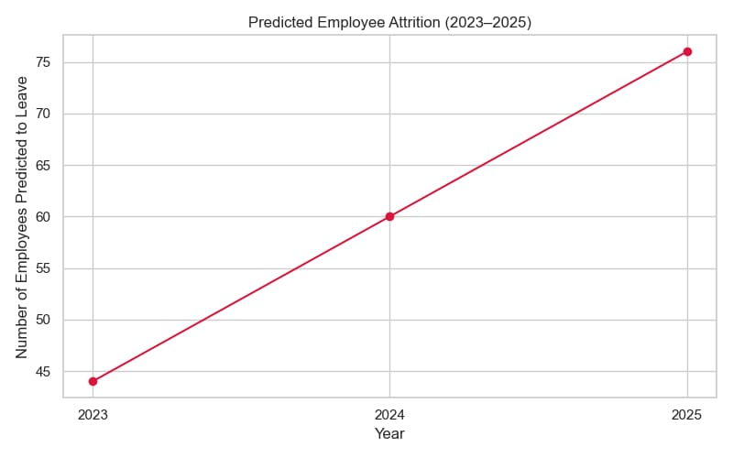
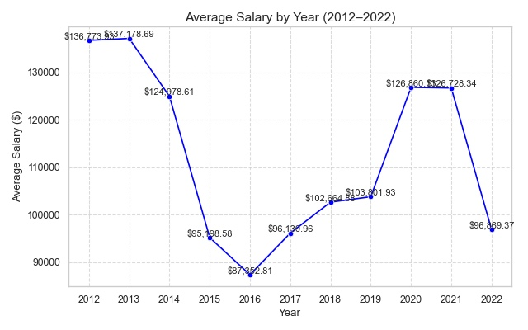
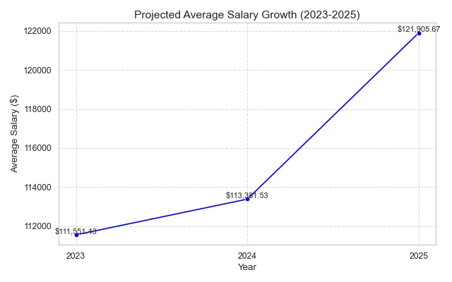
Forecasting Trends :

Slide 16

Data Visualization :
Prepare a report summarizing the project work by Tableau.
Our report consists of four dashboards and one summarize dashboard.
( Employees, Salary, Attrition , Performance & Summary ) dashboards.
Designed for HR decision-makers to explore data easily.

Slide 17
Recommendations :
Launch engagement programs for Sales & Tech departments
Improve internal promotion cycles
Offer hybrid work options for long-distance employees
Increase training opportunities for mid-career employees
Use forecasts for strategic workforce planning

Slide 18



Thank you
Eng/ Ahmed Samir

Slide 19
Thank you
Thank you for your attention ☺
We are happy to take any questions
Let’s connect to Explor more data-driven solutions :
LinkedIn :
Abeer , Rahma & Malek
GitHub

